Slide 1

POWER
PLATFORM
COURSE SLIDES · WSQ
Applications Integration with Power Apps and Power Automate
WSQ Course Code: TGS-2022015539
Conducted by Tertiary Infotech Academy Pte Ltd · UEN 201200696W
Version v8.0 · 4 September 2026
© 2026 Tertiary Infotech Academy Pte Ltd. All rights reserved. · www.tertiarycourses.com.sg

Slide 2
COURSE ADMINISTRATION
Welcome & Housekeeping
Applications Integration with Power Apps and Power Automate · TGS-2022015539
© 2026 Tertiary Infotech Academy Pte Ltd
2

Slide 3
TRAQOM · SSG DIGITAL ATTENDANCE
Digital Attendance (Mandatory)
Three times a day
Take the AM, PM and Assessment digital attendance — mandatory for every WSQ-funded course.
Trainer shows the QR
The trainer or administrator displays the digital attendance QR code from the SSG portal.
1
2
Scan and submit
Scan the QR code with your mobile phone camera and submit your attendance.
75% minimum
A minimum of 75% attendance is required to be eligible for assessment and funding.
3
4
Applications Integration with Power Apps and Power Automate · TGS-2022015539
© 2026 Tertiary Infotech Academy Pte Ltd
3

Slide 4
YOUR TRAINER · GENERAL
About the Trainer
NAME
____________________________________________
?
TITLE / DESIGNATION
____________________________________________
QUALIFICATIONS
____________________________________________
Your Trainer
AREAS OF EXPERTISE
____________________________________________
General Trainer template — to be completed by the trainer
TRAINING & INDUSTRY EXPERIENCE
____________________________________________
CONTACT
____________________________________________
Applications Integration with Power Apps and Power Automate · TGS-2022015539
© 2026 Tertiary Infotech Academy Pte Ltd
4

Slide 5
YOUR TRAINER
About the Trainer
ROLE
Principal Trainer, Tertiary Infotech Academy Pte Ltd
AA
EXPERTISE
Microsoft Power Platform, application integration, low-code development and business process automation.
Dr Alfred Ang
DELIVERS
WSQ courses on Power Apps, Power Automate, Power BI and applications integration.
Principal Trainer Tertiary Infotech Academy Pte Ltd
FOUNDER
Founder and lead instructor at Tertiary Infotech / Tertiary Courses.
Applications Integration with Power Apps and Power Automate · TGS-2022015539
© 2026 Tertiary Infotech Academy Pte Ltd
5

Slide 6
ICE-BREAKER
Let's Know Each Other
• Your name, organisation and role.
• The systems you work with day to day — Excel, SharePoint, Outlook, a line-of-business app?
• One manual, repetitive process in your work that you would most like to automate.
Applications Integration with Power Apps and Power Automate · TGS-2022015539
© 2026 Tertiary Infotech Academy Pte Ltd
6

Slide 7
HOUSEKEEPING
Ground Rules
Set your mobile phone to silent mode.
Participate actively — no question is too small.
1
2
Mutual respect: agree to disagree.
One conversation at a time.
3
4
Be punctual; return from breaks on time.
75% attendance is required.
5
6
Applications Integration with Power Apps and Power Automate · TGS-2022015539
© 2026 Tertiary Infotech Academy Pte Ltd
7

Slide 8
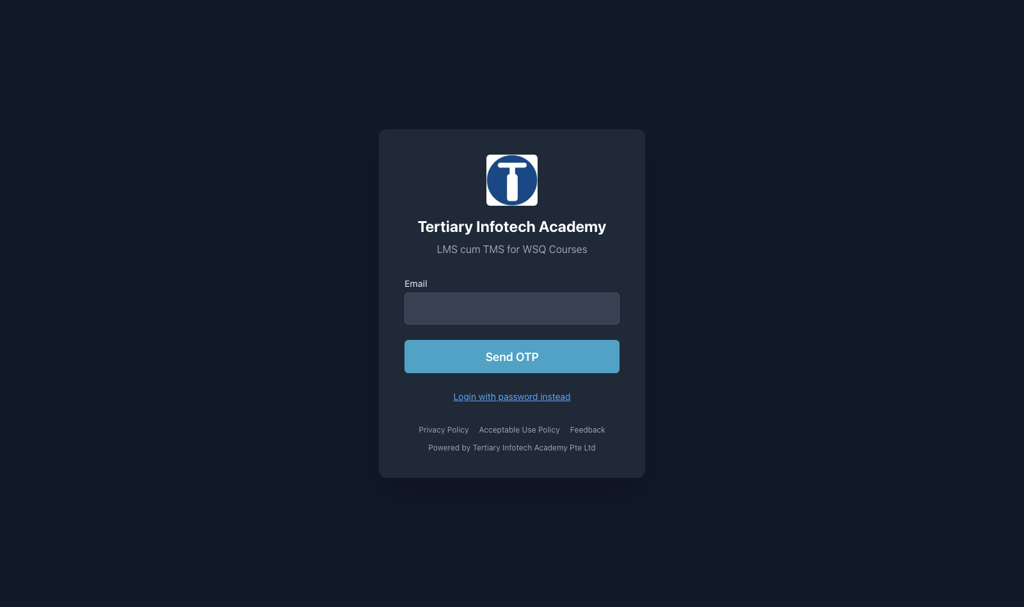
LMS / TMS · lms-tms.tertiaryinfotech.com
Download Your Course Material
WHAT TO LOOK AT
Log in with your registration e-mail, open this course, and download the Trainer Slides, Learner Guide and Lesson Plan. You may use them during the open-book assessment.
Applications Integration with Power Apps and Power Automate · TGS-2022015539
© 2026 Tertiary Infotech Academy Pte Ltd
8

Slide 9
SKILLS FRAMEWORK · TSC
Skills Framework Alignment
TSC Title
Applications Integration
TSC Code
ICT-DIT-3003-1.1 · Proficiency Level 3
1
2
K1 / K2
Types of middleware and their features; proper usage of middleware.
K3 / K5
Platforms on which applications run; functions of Application Programming Interfaces.
3
4
K4
Potential technical, compatibility or performance issues in application integration.
A1 – A8
Identify opportunities, scan feasibility, integrate, support APIs, test, verify, highlight issues and mitigate them.
5
6
Applications Integration with Power Apps and Power Automate · TGS-2022015539
© 2026 Tertiary Infotech Academy Pte Ltd
9

Slide 10
SCHEDULE
Lesson Plan — 2 Days, 8 hours/day
Day 1
Day 2
• Day 1 — Opportunities, feasibility and building automation with Power Automate
– Digital Attendance (AM) · Introductions · Learning Outcomes
– Topic 1: Opportunities for Using Power Platform Apps (Labs 1–2)
– Lunch Break · Digital Attendance (PM)
– Topic 2: Power Automate (Labs 3–6)
• Day 2 — Building canvas apps, integrating them with flows, and assessment
– Topic 3: Power Apps (Labs 7–10)
– Lunch Break · Digital Attendance (PM)
– Topic 4: Integrate Power Apps and Power Automate (Labs 11–14)
– TRAQOM Survey · Digital Attendance (Assessment)
– Final Assessment (WA 1 hr + PP 1.5 hrs)
Applications Integration with Power Apps and Power Automate · TGS-2022015539
© 2026 Tertiary Infotech Academy Pte Ltd
10

Slide 11
WHAT YOU'LL ACHIEVE
Learning Outcomes
LO1 · Identify opportunities
Identify opportunities to use Power Platform apps and perform a feasibility scan for potential application integration.
LO2 · Utilise Power Automate
Utilise and test Power Automate flows for business automation.
1
2
LO3 · Create Power Apps
Create Power Apps canvas apps and verify their functionalities.
LO4 · Improve with flows
Improve Power Apps with Power Automate flows, and resolve integration issues.
3
4
Applications Integration with Power Apps and Power Automate · TGS-2022015539
© 2026 Tertiary Infotech Academy Pte Ltd
11

Slide 12
FOUR TOPICS · 14 HANDS-ON LABS
Course Outline
1
Topic 1 — Opportunities for Using Power Platform Apps
The integration landscape · middleware types · the Power Platform family · the feasibility scan · connectors.
2
Topic 2 — Power Automate
Cloud flow types · triggers and actions · dynamic content · conditions and branching · approvals · testing.
3
Topic 3 — Power Apps
Canvas vs model-driven · data sources · Power Fx · custom connectors and APIs · publishing and sharing.
4
Topic 4 — Integrate Power Apps and Power Automate
Calling a flow from an app · returning data · end-to-end approvals · troubleshooting and delegation.
Applications Integration with Power Apps and Power Automate · TGS-2022015539
© 2026 Tertiary Infotech Academy Pte Ltd
12

Slide 13
BEFORE YOU START
Briefing for Assessment
Do · Clear your desk
Place phones and other materials under the table or on the floor.
Don't · No recording
No photos or recording of assessment scripts.
1
2
Don't · No discussion
Work individually — no discussion during the assessment.
Do · Black or blue pen
Use a black or blue pen for hard-copy assessments.
3
4
Don't · No correction fluid
No liquid paper or correction tape may be used.
Do · Stop on time
Scripts are collected when time is up.
5
6
Applications Integration with Power Apps and Power Automate · TGS-2022015539
© 2026 Tertiary Infotech Academy Pte Ltd
13

Slide 14
FINAL ASSESSMENT
Assessment
Written Assessment (WA)
Short-Answer Questions (SAQ) · 1 hour · open book. Five questions covering K1–K5.
Practical Performance (PP)
Hands-on scenario tasks · 1.5 hours · open book. Four tasks covering A1–A8.
1
2
Open book
You may use the course slides, the Learner Guide and approved materials only.
Eligibility
A minimum of 75% attendance is required to be eligible for assessment and funding.
3
4
Result
You are assessed as Competent (C) or Not Yet Competent (NYC) on each instrument.
Appeals
An appeal process is available if you wish to contest an assessment outcome.
5
6
Applications Integration with Power Apps and Power Automate · TGS-2022015539
© 2026 Tertiary Infotech Academy Pte Ltd
14

Slide 15
ON ASSESSMENT DAY
Assessment Flow
1
2
3
4
5
TRAQOM survey
Digital attendance
Sit WA then PP
Submit on the LMS
Sign the record
QR code on the LMS
Scan the SSG QR
Open book · 1h + 1.5h
Upload your answers
Assessment Summary
REMEMBER
All five steps are mandatory for WSQ funding — missing the digital attendance or the TRAQOM survey can invalidate your claim.
Applications Integration with Power Apps and Power Automate · TGS-2022015539
© 2026 Tertiary Infotech Academy Pte Ltd
15

Slide 16
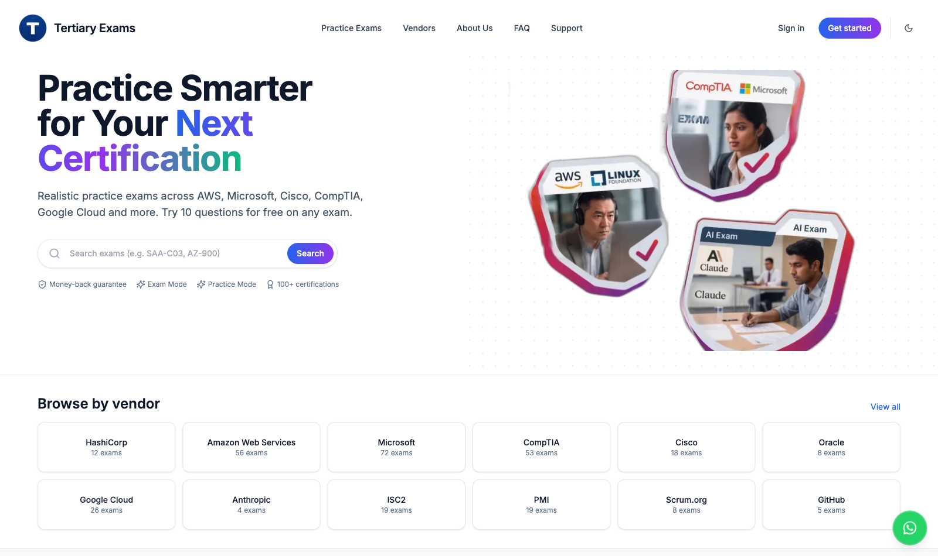
PRACTICE EXAM · exams.tertiaryinfotech.com
Practice Before the Assessment
WHAT TO LOOK AT
Work through the practice questions at exams.tertiaryinfotech.com to rehearse the knowledge questions before you sit the Written Assessment.
Applications Integration with Power Apps and Power Automate · TGS-2022015539
© 2026 Tertiary Infotech Academy Pte Ltd
16

Slide 17
WSQ FUNDING
Criteria for Funding
Attendance
A minimum attendance rate of 75%, based on the SSG Digital Attendance record.
Assessment
Complete both assessment components and be assessed as 'Competent'.
1
2
Digital attendance
Scan the SSG QR code for AM, PM and Assessment on every training day.
TRAQOM survey
Complete the mandatory TRAQOM course feedback survey on the LMS.
3
4
Applications Integration with Power Apps and Power Automate · TGS-2022015539
© 2026 Tertiary Infotech Academy Pte Ltd
17

Slide 18
LAB ENVIRONMENT
Set Up Before We Start
Microsoft 365 account
Sign in with the training account your trainer issues — it carries the Power Platform licence.
The course environment
Switch the environment picker to TGS-2022015539-Applications Integration with Power Apps and Power Automate.
1
2
Power Automate
Open make.powerautomate.com — this is where you build every flow.
Power Apps
Open make.powerapps.com — this is where you build every app.
3
4
Lab data
Download the lab workbooks from the LMS and upload them to your OneDrive for Business.
Microsoft Teams
Approvals arrive in Teams, so make sure you can sign in to it.
5
6
Applications Integration with Power Apps and Power Automate · TGS-2022015539
© 2026 Tertiary Infotech Academy Pte Ltd
18

Slide 19
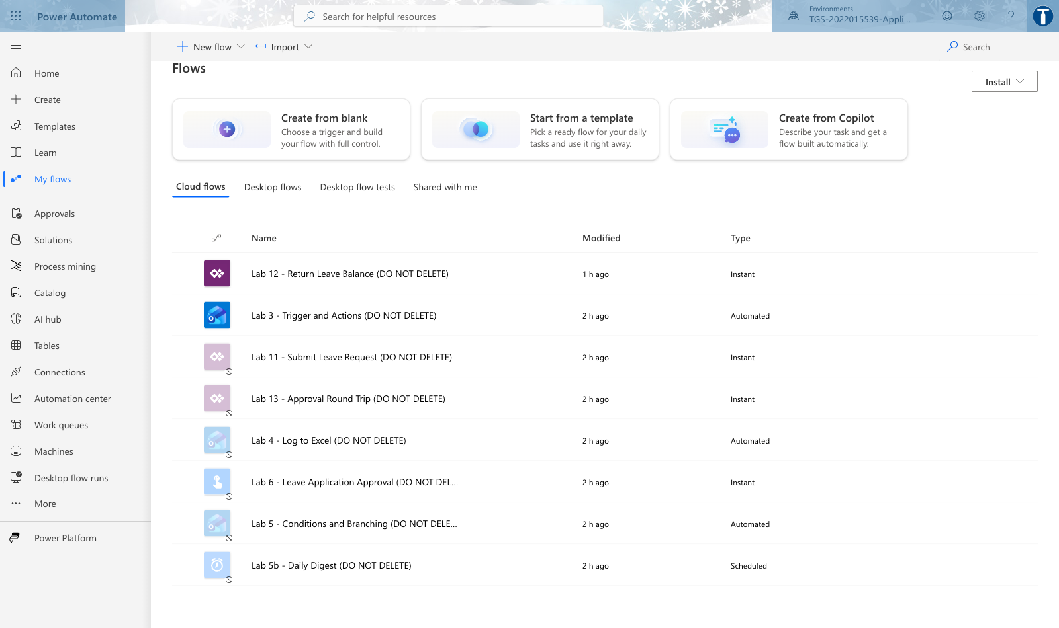
THE COURSE ENVIRONMENT · PRE-BUILT FLOWS
Your Lab Environment
WHAT TO LOOK AT
Every flow you build is named 'Lab N - ... (DO NOT DELETE)'. The environment picker at the top right must read the course environment before you build anything.
Applications Integration with Power Apps and Power Automate · TGS-2022015539
© 2026 Tertiary Infotech Academy Pte Ltd
19

Slide 20
CORE CONCEPTS
Application Integration and the Power Platform
Applications Integration with Power Apps and Power Automate · TGS-2022015539
© 2026 Tertiary Infotech Academy Pte Ltd
20

Slide 21
WHY THIS COURSE
Integration is what happens between the systems.
Most business software is bought, not built. The value you add is making the pieces talk to each other — and middleware is the layer where that happens.
Applications Integration with Power Apps and Power Automate · TGS-2022015539
© 2026 Tertiary Infotech Academy Pte Ltd
21

Slide 22
K1 · FOUNDATIONS
What is Application Integration?
Connecting systems
Making two or more applications exchange data and trigger each other's functions without a human retyping anything.
Why it matters
Every manual re-keying step is slow, costs money and introduces errors that are expensive to find later.
1
2
Point-to-point vs hub
Direct connections are quick but multiply; a hub (middleware) keeps the number of connections manageable.
What you integrate
Devices, databases, software and applications — the four categories named in the TSC.
3
4
Applications Integration with Power Apps and Power Automate · TGS-2022015539
© 2026 Tertiary Infotech Academy Pte Ltd
22

Slide 23
K1 · TYPES OF MIDDLEWARE
Types of Middleware and Their Features
Type
What it does
Typical example
Strength
Integration platform (iPaaS)
Cloud service that connects apps with prebuilt connectors
Power Automate, Zapier, MuleSoft
Fast to build, no servers to run
Message broker
Queues messages between producers and consumers
Azure Service Bus, RabbitMQ
Decouples systems; survives outages
API gateway
Fronts and secures a set of APIs
Azure API Management
Central auth, throttling, versioning
ETL / data pipeline
Moves and reshapes data in bulk on a schedule
Azure Data Factory, SSIS
High volume, scheduled loads
RPA
Drives a user interface when there is no API
Power Automate Desktop
Reaches legacy systems with no API
WHEN IT MATTERS Power Platform is an iPaaS with RPA attached — that is why it can reach both modern SaaS APIs and legacy desktop applications.
Applications Integration with Power Apps and Power Automate · TGS-2022015539
© 2026 Tertiary Infotech Academy Pte Ltd
23

Slide 24
THE PRODUCT FAMILY
The Microsoft Power Platform Family
Power Apps
Build custom business apps quickly with low code — canvas apps and model-driven apps.
Power Automate
Automate workflows between applications and services — the middleware in this course.
1
2
Power BI
Analyse and visualise data from across those connected systems.
Copilot Studio
Build conversational agents over the same data and actions.
3
4
Dataverse
The secure, governed data store that underpins the whole platform.
Connectors
1,000+ prebuilt connectors plus custom connectors — the API surface that ties it all together.
5
6
Applications Integration with Power Apps and Power Automate · TGS-2022015539
© 2026 Tertiary Infotech Academy Pte Ltd
24

Slide 25
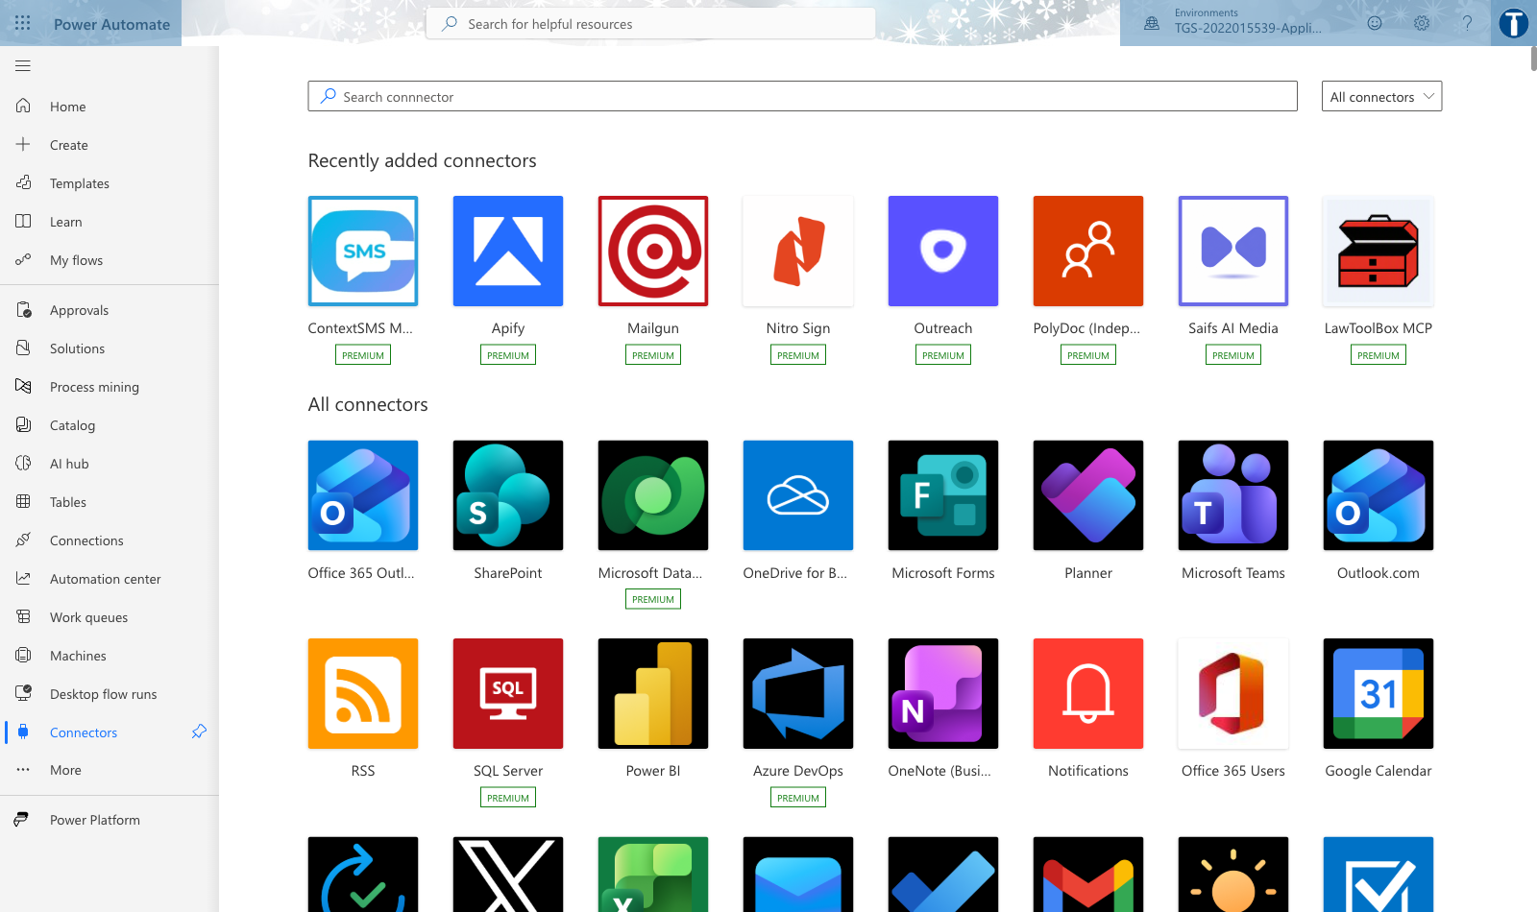
K5 · APIs AND CONNECTORS
Connectors — the API Surface of the Platform
WHAT TO LOOK AT
A connector is a packaged API. Standard connectors are included; Premium connectors need a licence; a custom connector wraps any REST API you can reach.
Applications Integration with Power Apps and Power Automate · TGS-2022015539
© 2026 Tertiary Infotech Academy Pte Ltd
25

Slide 26
K2 · THE EXECUTION MODEL
How a Cloud Flow Executes
1
2
3
4
5
Trigger fires
Inputs are read
Actions run in order
Data passes forward
Run is recorded
An event occurs
Trigger outputs
Each calls a connector
Dynamic content
28-day run history
THE POINT
A flow is a trigger plus an ordered set of actions. Everything you build in Topic 2 is a variation on this one shape.
Applications Integration with Power Apps and Power Automate · TGS-2022015539
© 2026 Tertiary Infotech Academy Pte Ltd
26

Slide 27
A2 · FEASIBILITY DECISION
Is Power Platform the Right Middleware Here?
YES — build it low-code
Does a connector exist, and is the data ready?
Use Power Automate for the integration and Power Apps for the interface. Fastest route to value, and maintainable by the business.
NO — reconsider
No connector? Build a custom connector or use Azure Integration Services. Data not ready? Fix the source first — integration will not repair bad data.
A feasibility scan that approves everything is not a scan. Recording a defensible 'no' is as valuable as approving a build.
Applications Integration with Power Apps and Power Automate · TGS-2022015539
© 2026 Tertiary Infotech Academy Pte Ltd
27

Slide 28
A2 · THE FEASIBILITY SCAN
The Six Feasibility Criteria
Connector availability
Does a standard connector exist, is it Premium, or must you build a custom connector?
Data readiness
Is the source structured, does it have a stable key, is the Excel range a real Table?
1
2
Licensing
Premium connectors and Dataverse need the right plan — check before you design.
Security & governance
Who owns the data, which account runs the flow, does a DLP policy block the combination?
3
4
Performance
Row counts, delegation support and connector throttling limits.
Maintainability
Who supports this after you build it, and how will they know when it breaks?
5
6
Applications Integration with Power Apps and Power Automate · TGS-2022015539
© 2026 Tertiary Infotech Academy Pte Ltd
28

Slide 29
LESSON PLAN · TIME ALLOCATION
Where Course Time Goes — Topic Weighting
WHAT THE DATA SHOWS
Topics 2 and 3 carry the most time because that is where the practical ability assessed by the PP is built. Topic 4 is shorter but joins everything together — and is where the A7/A8 troubleshooting marks sit.
Applications Integration with Power Apps and Power Automate · TGS-2022015539
© 2026 Tertiary Infotech Academy Pte Ltd
29

Slide 30
K1 · WHY INTEGRATE
The Cost of Manual Re-Keying
WHAT THE DATA SHOWS
Indicative figures for teaching the trade-off, not a benchmark. The shape is what matters: integration cuts both handling time and error rate, and the error reduction is usually worth more than the time saved.
Applications Integration with Power Apps and Power Automate · TGS-2022015539
© 2026 Tertiary Infotech Academy Pte Ltd
30

Slide 31
K3 · CHOOSING AN APP TYPE
Canvas App vs Model-Driven App
Dimension
Canvas app
Model-driven app
Who designs the UI
You do — pixel by pixel
Generated from the data model
Data source
Any connector — Excel, SharePoint, SQL, APIs
Dataverse only
Best for
Task-focused apps with a specific look
Data-heavy, process-driven applications
Skill needed
Power Fx formulas, layout sense
Data modelling, forms and views
Build speed
Fast for small apps
Fast for large, standard CRUD apps
WHEN IT MATTERS This course builds canvas apps, because a canvas app can bind to any connector — which is what makes it an integration surface.
Applications Integration with Power Apps and Power Automate · TGS-2022015539
© 2026 Tertiary Infotech Academy Pte Ltd
31

Slide 32
K2 · FOUR SHAPES OF FLOW
Cloud Flow Types
Automated
Starts when an event happens in a connected service — a mail arrives, a file is created, a row is added.
Instant
Started by a person, from a button, the mobile app, or from inside a canvas app.
1
2
Scheduled
Runs on a recurrence — hourly, daily, weekly — for digests, syncs and housekeeping.
Desktop (RPA)
Drives a user interface for systems that have no API at all.
3
4
Applications Integration with Power Apps and Power Automate · TGS-2022015539
© 2026 Tertiary Infotech Academy Pte Ltd
32

Slide 33
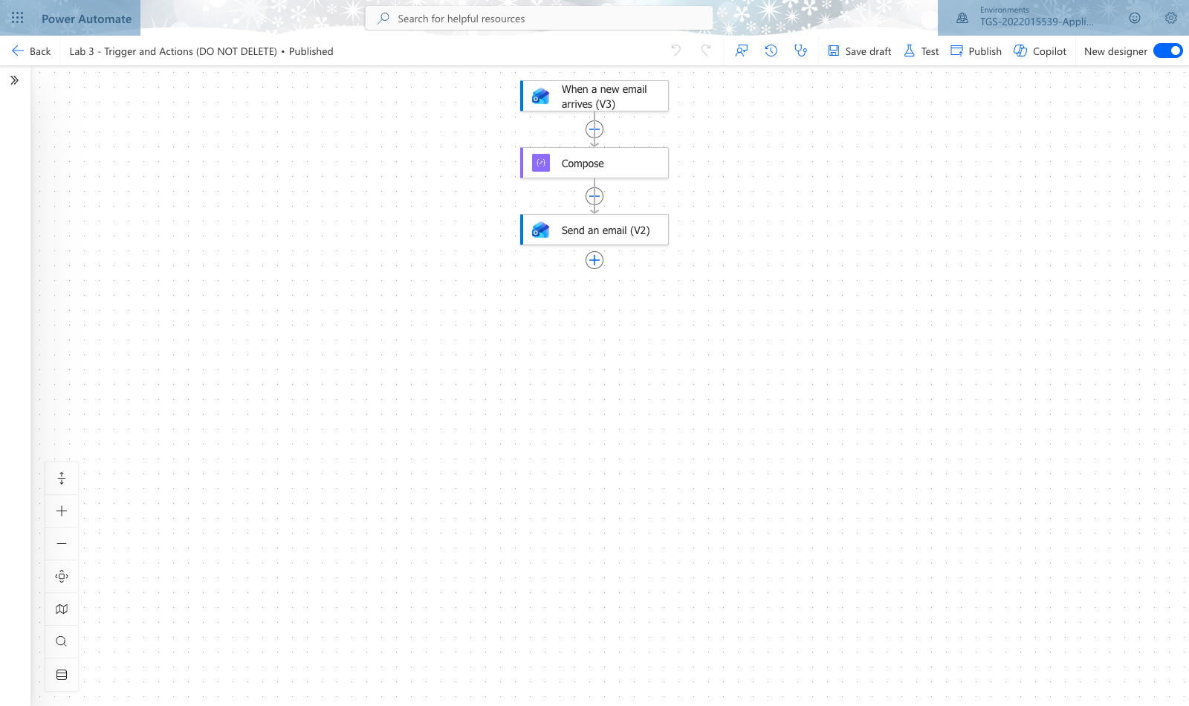
K2 · WHERE YOU WILL WORK
The Power Automate Designer
WHAT TO LOOK AT
The trigger sits at the top, actions run downward, and the + between them adds a step. The right-hand pane configures whichever action is selected.
Applications Integration with Power Apps and Power Automate · TGS-2022015539
© 2026 Tertiary Infotech Academy Pte Ltd
33

Slide 34
K2 · WORKED EXAMPLE
Reading a Flow Definition
Every flow you build is this shape underneath — learn to read it once and the designer stops being a mystery.
"triggers": {
"When_a_new_email_arrives_(V3)": {
"type": "OpenApiConnectionNotification",
"inputs": { "parameters": {
"folderPath": "Inbox",
"subjectFilter": "SERVICE" } } } },
"actions": {
"Compose": { "type": "Compose",
"inputs": "@{triggerOutputs()?['body/from']}" },
"Send_an_email_(V2)": {
"runAfter": { "Compose": ["Succeeded"] } } }
triggers
The single event that starts the run. A flow has exactly one.
subjectFilter
Narrows what fires the flow — cheaper and clearer than filtering later.
@{triggerOutputs()...}
Dynamic content: how data crosses from one action to the next.
runAfter
The dependency that orders the actions, and what to do when one fails.
Applications Integration with Power Apps and Power Automate · TGS-2022015539
© 2026 Tertiary Infotech Academy Pte Ltd
34

Slide 35
K3 · THE APP FORMULA LANGUAGE
Power Fx — the Formula Language
Excel-like
If you can write an Excel formula, you can write Power Fx. Same mental model, same functions.
Declarative
You set a property to a formula; it recalculates whenever its inputs change.
1
2
Binds controls to data
Items, Text, Visible, DisplayMode and OnSelect are the properties you will use most.
Delegation matters
Some functions run in the data source; others pull rows to the device. Know which.
3
4
Applications Integration with Power Apps and Power Automate · TGS-2022015539
© 2026 Tertiary Infotech Academy Pte Ltd
35

Slide 36
K4 · A7 / A8 · DIAGNOSIS
The Three Classes of Integration Issue
Class
What it looks like
Typical cause
How you fix it
Technical
Flow fails with 401/403; connection shows an error
Expired or revoked connection, wrong account, DLP policy
Re-authenticate the connection; check DLP; use a service account
Compatibility
Schema validation error; wrong data in the target field
Type mismatch — text passed where a number is expected; date format
Coerce the type at the call site; agree a contract for the payload
Performance
Blue delegation warning; only the first rows appear; timeouts
Non-delegable function; too many rows; connector throttling
Rewrite to a delegable filter; reduce rows at source; batch the calls
WHEN IT MATTERS Lab 14 makes you provoke one of each on purpose — diagnosing a fault you caused is the fastest way to learn to diagnose one you did not.
Applications Integration with Power Apps and Power Automate · TGS-2022015539
© 2026 Tertiary Infotech Academy Pte Ltd
36

Slide 37
K4 · THE CLASSIC PERFORMANCE TRAP
Delegation is the defect you will meet most.
When a formula cannot be delegated, Power Apps pulls only the first 500 rows to the device and filters there — so your app silently shows the wrong answer instead of failing loudly.
Applications Integration with Power Apps and Power Automate · TGS-2022015539
© 2026 Tertiary Infotech Academy Pte Ltd
37

Slide 38
01
TOPIC 01
Opportunities for Using Power Platform Apps
Integration landscape · feasibility scan · Power Platform product family
Applications Integration with Power Apps and Power Automate · TGS-2022015539
© 2026 Tertiary Infotech Academy Pte Ltd
38

Slide 39
MAPS TO K1, A1, A2
Key Concepts — Opportunities for Using Power Platform Apps
Application integration connects disparate systems so data and functions flow between them without manual re-keying.
Middleware is the software layer that sits between applications and brokers that exchange — Power Platform is low-code integration middleware.
1
2
The Power Platform family: Power Apps (build), Power Automate (automate), Power BI (analyse), Copilot Studio (converse), Dataverse (store).
3
Applications Integration with Power Apps and Power Automate · TGS-2022015539
© 2026 Tertiary Infotech Academy Pte Ltd
39

Slide 40
MAPS TO K1, A1, A2
Key Concepts — Opportunities for Using Power Platform Apps (continued)
A feasibility scan weighs business value, data readiness, connector availability, licensing, security and governance before you build.
Connectors are the API surface of the platform: 1,000+ prebuilt connectors plus custom connectors for any REST API.
1
2
Applications Integration with Power Apps and Power Automate · TGS-2022015539
© 2026 Tertiary Infotech Academy Pte Ltd
40

Slide 41
WHAT YOU'LL DO
Hands-On Labs — Opportunities for Using Power Platform Apps
Lab 1
Lab 2
• Integration Opportunity Scan
• Feasibility Scan and Middleware Selection
Applications Integration with Power Apps and Power Automate · TGS-2022015539
© 2026 Tertiary Infotech Academy Pte Ltd
41

Slide 42
TOPIC 01 · HANDS-ON
Integration Opportunity Scan
LAB 1
K1 Types of middleware and their features; A1 Identify opportunities for creating connections among various devices, databases, software and applications.
Working from the KinetEco service-desk scenario, map the organisation's current manual process end to end and mark every point where data is re-keyed between systems. Each re-keying point is an integration opportunity. Classify each candidate by the systems it joins (device, database, software, application) and score it for volume, error rate and business impact.
YOU'LL BUILD
TOOLCHAIN
DONE WHEN
A completed Integration Opportunity Register listing at least six candidate integrations, each classified and scored.
Power Platform admin center, Excel, Power Automate connector catalogue
Your register lists at least six candidates, each naming a source system, a target system, a connector and a score. The top-ranked candidate should be the service-call intake — the one you automate in Lab 3.
Applications Integration with Power Apps and Power Automate · TGS-2022015539
© 2026 Tertiary Infotech Academy Pte Ltd
42

Slide 43
LAB 1 · PROCESS MAP
How Lab 1 Runs
1
2
3
4
5
Open the environment
Read the manual process
Map the swimlane
Browse the connectors
Score and rank
course env picker
KinetEco service calls
mark every re-keying
source and target
volume · errors · impact
THE POINT
K1 Types of middleware and their features; A1 Identify opportunities for creating connections among various devices, databases, software and applications.
Applications Integration with Power Apps and Power Automate · TGS-2022015539
© 2026 Tertiary Infotech Academy Pte Ltd
43

Slide 44
LAB 1 · VERIFY
Integration Opportunity Scan
✅ Expected result
Your register lists at least six candidates, each naming a source system, a target system, a connector and a score. The top-ranked candidate should be the service-call intake — the one you automate in Lab 3.
IF IT DOESN'T WORK
Nothing happens
Auth or 401 error
ModuleNotFoundError
Check the .env file is in the labs folder and the key has no quotes or spaces.
Re-copy the API key from AI Studio; confirm GOOGLE_GENAI_USE_VERTEXAI=0.
Run uv sync again, and prefix commands with uv run so the venv is used.
Applications Integration with Power Apps and Power Automate · TGS-2022015539
© 2026 Tertiary Infotech Academy Pte Ltd
44

Slide 45
TOPIC 01 · HANDS-ON
Feasibility Scan and Middleware Selection
LAB 2
A2 Perform feasibility scan and assessment to identify potential middleware to be used; K1 Types of middleware and their features.
Take the top three opportunities from Lab 1 and run a structured feasibility scan against six criteria: connector availability, data readiness, licensing, security and governance, performance/delegation, and maintainability. Decide for each whether Power Platform is the right middleware — and be prepared to justify a 'no'.
YOU'LL BUILD
TOOLCHAIN
DONE WHEN
A Feasibility Assessment Matrix scoring three candidates against six criteria, with a documented Build / Defer / Reject decision and justification for each.
Power Platform admin center, connector catalogue, Microsoft licensing documentation
Each of the three candidates has six scores, a total, and a decision with justification. At least one candidate should be Deferred or Rejected with a defensible reason — a scan where everything passes is not a scan.
Applications Integration with Power Apps and Power Automate · TGS-2022015539
© 2026 Tertiary Infotech Academy Pte Ltd
45

Slide 46
LAB 2 · PROCESS MAP
How Lab 2 Runs
1
2
3
4
5
Confirm connectors exist
Assess data readiness
Check security and DLP
Assess performance
Decide and justify
Standard or Premium
Table? stable key?
who owns the data
rows and delegation
Build · Defer · Reject
THE POINT
A2 Perform feasibility scan and assessment to identify potential middleware to be used; K1 Types of middleware and their features.
Applications Integration with Power Apps and Power Automate · TGS-2022015539
© 2026 Tertiary Infotech Academy Pte Ltd
46

Slide 47
LAB 2 · VERIFY
Feasibility Scan and Middleware Selection
✅ Expected result
Each of the three candidates has six scores, a total, and a decision with justification. At least one candidate should be Deferred or Rejected with a defensible reason — a scan where everything passes is not a scan.
IF IT DOESN'T WORK
Nothing happens
Auth or 401 error
ModuleNotFoundError
Check the .env file is in the labs folder and the key has no quotes or spaces.
Re-copy the API key from AI Studio; confirm GOOGLE_GENAI_USE_VERTEXAI=0.
Run uv sync again, and prefix commands with uv run so the venv is used.
Applications Integration with Power Apps and Power Automate · TGS-2022015539
© 2026 Tertiary Infotech Academy Pte Ltd
47

Slide 48
TOPIC RECAP
Recap — Opportunities for Using Power Platform Apps
• You can now: K1 Types of middleware and their features; A1 Identify opportunities for creating connections among various devices, databases, software and applications.
• You can now: A2 Perform feasibility scan and assessment to identify potential middleware to be used; K1 Types of middleware and their features.
Applications Integration with Power Apps and Power Automate · TGS-2022015539
© 2026 Tertiary Infotech Academy Pte Ltd
48

Slide 49
02
TOPIC 02
Power Automate
Cloud flows · triggers and actions · conditions · approvals · testing
Applications Integration with Power Apps and Power Automate · TGS-2022015539
© 2026 Tertiary Infotech Academy Pte Ltd
49

Slide 50
MAPS TO K2, A3, A5
Key Concepts — Power Automate
A cloud flow is a trigger plus a sequence of actions; the trigger is the event that starts the flow.
Flow types: automated (event-driven), instant (manual/button), scheduled (recurrence), and desktop (RPA).
1
2
Dynamic content passes output from one action into the input of the next — this is how data crosses application boundaries.
3
Applications Integration with Power Apps and Power Automate · TGS-2022015539
© 2026 Tertiary Infotech Academy Pte Ltd
50

Slide 51
MAPS TO K2, A3, A5
Key Concepts — Power Automate (continued)
Conditions, loops and scopes give a flow its control logic; expressions add computation.
Testing is a first-class step: Flow checker, Test, and the 28-day run history are how you prove a connection works.
1
2
Applications Integration with Power Apps and Power Automate · TGS-2022015539
© 2026 Tertiary Infotech Academy Pte Ltd
51

Slide 52
WHAT YOU'LL DO
Hands-On Labs — Power Automate
Labs 3–4
Labs 5–6
• Trigger and Actions
• Log to Excel
• Conditions and Branching
• Leave Application Approval
Applications Integration with Power Apps and Power Automate · TGS-2022015539
© 2026 Tertiary Infotech Academy Pte Ltd
52

Slide 53
TOPIC 02 · HANDS-ON
Trigger and Actions
LAB 3
K2 Proper usage of middleware; A3 Utilise middleware to integrate data and functions across application programs.
Build your first cloud flow: an automated flow that fires when a new service-call item arrives and sends a formatted notification. This is the atom of every integration — one trigger, one or more actions, and dynamic content carrying data between them.
YOU'LL BUILD
TOOLCHAIN
DONE WHEN
Flow 'Lab 3 - Trigger and Actions (DO NOT DELETE)' — an automated cloud flow with a trigger, a compose step and a notification action, tested with a successful run.
Power Automate, Office 365 Outlook, Compose
The run history shows one Succeeded run. Expanding the Compose step shows the sender, subject and timestamp carried from the trigger, and the notification email arrives in your inbox.
Applications Integration with Power Apps and Power Automate · TGS-2022015539
© 2026 Tertiary Infotech Academy Pte Ltd
53

Slide 54
LAB 3 · PROCESS MAP
How Lab 3 Runs
1
2
3
4
5
Create an automated flow
Pick the email trigger
Filter what fires it
Compose the details
Send the notification
new cloud flow
When a new email arrives
subject contains SERVICE
from · subject · time
and test the run
THE POINT
K2 Proper usage of middleware; A3 Utilise middleware to integrate data and functions across application programs.
Applications Integration with Power Apps and Power Automate · TGS-2022015539
© 2026 Tertiary Infotech Academy Pte Ltd
54

Slide 55
LAB 3 · VERIFY
Trigger and Actions
✅ Expected result
The run history shows one Succeeded run. Expanding the Compose step shows the sender, subject and timestamp carried from the trigger, and the notification email arrives in your inbox.
IF IT DOESN'T WORK
Nothing happens
Auth or 401 error
ModuleNotFoundError
Check the .env file is in the labs folder and the key has no quotes or spaces.
Re-copy the API key from AI Studio; confirm GOOGLE_GENAI_USE_VERTEXAI=0.
Run uv sync again, and prefix commands with uv run so the venv is used.
Applications Integration with Power Apps and Power Automate · TGS-2022015539
© 2026 Tertiary Infotech Academy Pte Ltd
55

Slide 56
TOPIC 02 · HANDS-ON
Log to Excel
LAB 4
A3 Utilise middleware to integrate data and functions across application programs; A5 Perform tests and checks on the connections between disparate application programs.
Extend Lab 3 so the service call is not merely announced but recorded. The flow writes a row into an Excel Online table in OneDrive, turning a notification into a durable integration between a mail system and a data store.
YOU'LL BUILD
TOOLCHAIN
DONE WHEN
Flow 'Lab 4 - Log to Excel (DO NOT DELETE)' writing one row per service call into a formatted Excel Table, verified by inspecting the workbook.
Power Automate, Office 365 Outlook, Excel Online (Business), OneDrive for Business
A new row appears in the ServiceCalls table for each test email. The deliberate rename produces a clear failure in run history, and restoring the name returns the flow to Succeeded.
Applications Integration with Power Apps and Power Automate · TGS-2022015539
© 2026 Tertiary Infotech Academy Pte Ltd
56

Slide 57
LAB 4 · PROCESS MAP
How Lab 4 Runs
1
2
3
4
5
Format data as a Table
Name the table
Copy the Lab 3 flow
Add a row to the table
Break it and fix it
Insert > Table
ServiceCalls
Save As
map dynamic content
rename, re-run, restore
THE POINT
A3 Utilise middleware to integrate data and functions across application programs; A5 Perform tests and checks on the connections between disparate application programs.
Applications Integration with Power Apps and Power Automate · TGS-2022015539
© 2026 Tertiary Infotech Academy Pte Ltd
57

Slide 58
LAB 4 · VERIFY
Log to Excel
✅ Expected result
A new row appears in the ServiceCalls table for each test email. The deliberate rename produces a clear failure in run history, and restoring the name returns the flow to Succeeded.
IF IT DOESN'T WORK
Nothing happens
Auth or 401 error
ModuleNotFoundError
Check the .env file is in the labs folder and the key has no quotes or spaces.
Re-copy the API key from AI Studio; confirm GOOGLE_GENAI_USE_VERTEXAI=0.
Run uv sync again, and prefix commands with uv run so the venv is used.
Applications Integration with Power Apps and Power Automate · TGS-2022015539
© 2026 Tertiary Infotech Academy Pte Ltd
58

Slide 59
TOPIC 02 · HANDS-ON
Conditions and Branching
LAB 5
K2 Proper usage of middleware; A3 Utilise middleware to integrate data and functions across application programs.
Real integrations rarely run in a straight line. Add a Condition so urgent service calls are escalated while routine ones are only logged, then add a scheduled digest flow that summarises the day's calls.
YOU'LL BUILD
TOOLCHAIN
DONE WHEN
Flow 'Lab 5 - Conditions and Branching (DO NOT DELETE)' with a working If yes / If no branch, plus a scheduled recurrence flow producing a daily digest.
Power Automate, Office 365 Outlook, Excel Online (Business), Recurrence
Run history shows the URGENT test taking the If yes branch and the routine test taking If no. The digest flow sends one email containing an HTML table of the logged calls.
Applications Integration with Power Apps and Power Automate · TGS-2022015539
© 2026 Tertiary Infotech Academy Pte Ltd
59

Slide 60
LAB 5 · PROCESS MAP
How Lab 5 Runs
1
2
3
4
5
Copy the Lab 4 flow
Add a Condition
Escalate on the yes branch
Log only on the no branch
Add a scheduled digest
Save As
subject contains URGENT
high-importance email
routine calls
daily at 18:00
THE POINT
K2 Proper usage of middleware; A3 Utilise middleware to integrate data and functions across application programs.
Applications Integration with Power Apps and Power Automate · TGS-2022015539
© 2026 Tertiary Infotech Academy Pte Ltd
60

Slide 61
LAB 5 · VERIFY
Conditions and Branching
✅ Expected result
Run history shows the URGENT test taking the If yes branch and the routine test taking If no. The digest flow sends one email containing an HTML table of the logged calls.
IF IT DOESN'T WORK
Nothing happens
Auth or 401 error
ModuleNotFoundError
Check the .env file is in the labs folder and the key has no quotes or spaces.
Re-copy the API key from AI Studio; confirm GOOGLE_GENAI_USE_VERTEXAI=0.
Run uv sync again, and prefix commands with uv run so the venv is used.
Applications Integration with Power Apps and Power Automate · TGS-2022015539
© 2026 Tertiary Infotech Academy Pte Ltd
61

Slide 62
TOPIC 02 · HANDS-ON
Leave Application Approval
LAB 6
A3 Utilise middleware to integrate data and functions across application programs; A5 Perform tests and checks on the connections between disparate application programs.
Add the human to the loop. Build an approval flow where a leave request is routed to an approver, the decision branches the flow, and the outcome is written back and notified — the canonical human-in-the-loop integration pattern.
YOU'LL BUILD
TOOLCHAIN
DONE WHEN
Flow 'Lab 6 - Leave Application Approval (DO NOT DELETE)' with a Start and wait for an approval action, an outcome condition, and write-back to Excel.
Power Automate, Approvals, Office 365 Outlook, Excel Online (Business), Microsoft Teams
Two runs complete: one Approved and one Rejected. Each produced the correct branch, the correct email, and a correctly-statused row in the LeaveLog table.
Applications Integration with Power Apps and Power Automate · TGS-2022015539
© 2026 Tertiary Infotech Academy Pte Ltd
62

Slide 63
LAB 6 · PROCESS MAP
How Lab 6 Runs
1
2
3
4
5
Create an instant flow
Add the request inputs
Start and wait for approval
Branch on the outcome
Write back and notify
manual trigger
applicant · type · days
first to respond
Approve or Reject
Excel row plus email
THE POINT
A3 Utilise middleware to integrate data and functions across application programs; A5 Perform tests and checks on the connections between disparate application programs.
Applications Integration with Power Apps and Power Automate · TGS-2022015539
© 2026 Tertiary Infotech Academy Pte Ltd
63

Slide 64
LAB 6 · VERIFY
Leave Application Approval
✅ Expected result
Two runs complete: one Approved and one Rejected. Each produced the correct branch, the correct email, and a correctly-statused row in the LeaveLog table.
IF IT DOESN'T WORK
Nothing happens
Auth or 401 error
ModuleNotFoundError
Check the .env file is in the labs folder and the key has no quotes or spaces.
Re-copy the API key from AI Studio; confirm GOOGLE_GENAI_USE_VERTEXAI=0.
Run uv sync again, and prefix commands with uv run so the venv is used.
Applications Integration with Power Apps and Power Automate · TGS-2022015539
© 2026 Tertiary Infotech Academy Pte Ltd
64

Slide 65
TOPIC RECAP
Recap — Power Automate
• You can now: K2 Proper usage of middleware; A3 Utilise middleware to integrate data and functions across application programs.
• You can now: A3 Utilise middleware to integrate data and functions across application programs; A5 Perform tests and checks on the connections between disparate application programs.
Applications Integration with Power Apps and Power Automate · TGS-2022015539
© 2026 Tertiary Infotech Academy Pte Ltd
65

Slide 66
03
TOPIC 03
Power Apps
Canvas apps · data sources · controls and formulas · publishing and sharing
Applications Integration with Power Apps and Power Automate · TGS-2022015539
© 2026 Tertiary Infotech Academy Pte Ltd
66

Slide 67
MAPS TO K3, K5, A4, A6
Key Concepts — Power Apps
Canvas apps give pixel-level control of the UI; model-driven apps generate the UI from the data model.
Apps run across platforms — browser, iOS, Android, Teams and embedded in SharePoint or Power BI.
1
2
A data source is reached through a connector; the same app can bind to Dataverse, Excel, SharePoint or a REST API.
3
Applications Integration with Power Apps and Power Automate · TGS-2022015539
© 2026 Tertiary Infotech Academy Pte Ltd
67

Slide 68
MAPS TO K3, K5, A4, A6
Key Concepts — Power Apps (continued)
Power Fx is the Excel-like formula language that binds controls to data and behaviour.
Publish, version and share are the app lifecycle: every save creates a version you can restore.
1
2
Applications Integration with Power Apps and Power Automate · TGS-2022015539
© 2026 Tertiary Infotech Academy Pte Ltd
68

Slide 69
WHAT YOU'LL DO
Hands-On Labs — Power Apps
Labs 7–8
Labs 9–10
• Canvas App from Excel Data
• Blank Canvas App with Power Fx
• Custom Connector and API Integration
• Cross-Platform Verification and Sharing
Applications Integration with Power Apps and Power Automate · TGS-2022015539
© 2026 Tertiary Infotech Academy Pte Ltd
69

Slide 70
TOPIC 03 · HANDS-ON
Canvas App from Excel Data
LAB 7
K3 Different types of platforms on which applications run; A4 Support API-level integration.
Create your first canvas app over the Excel table you built in Lab 4. Power Apps generates a three-screen browse/detail/edit app; you then read how each screen is wired so the generated app becomes something you can modify rather than a black box.
YOU'LL BUILD
TOOLCHAIN
DONE WHEN
Canvas app 'Lab 7 - Canvas App from Excel (DO NOT DELETE)' — a working three-screen app bound to the ServiceCalls Excel table, saved and published.
Power Apps Studio, Excel Online (Business), OneDrive for Business
The app browses, filters and sorts real service-call data; adding a record through the app writes a new row to the Excel table, and the app appears in the Apps list as published.
Applications Integration with Power Apps and Power Automate · TGS-2022015539
© 2026 Tertiary Infotech Academy Pte Ltd
70

Slide 71
LAB 7 · PROCESS MAP
How Lab 7 Runs
1
2
3
4
5
Open the maker portal
Start with Excel data
Save with the lab name
Read the Items formula
Sort, search and publish
check the environment
pick the table
three screens generated
how binding works
then check versions
THE POINT
K3 Different types of platforms on which applications run; A4 Support API-level integration.
Applications Integration with Power Apps and Power Automate · TGS-2022015539
© 2026 Tertiary Infotech Academy Pte Ltd
71

Slide 72
LAB 7 · VERIFY
Canvas App from Excel Data
✅ Expected result
The app browses, filters and sorts real service-call data; adding a record through the app writes a new row to the Excel table, and the app appears in the Apps list as published.
IF IT DOESN'T WORK
Nothing happens
Auth or 401 error
ModuleNotFoundError
Check the .env file is in the labs folder and the key has no quotes or spaces.
Re-copy the API key from AI Studio; confirm GOOGLE_GENAI_USE_VERTEXAI=0.
Run uv sync again, and prefix commands with uv run so the venv is used.
Applications Integration with Power Apps and Power Automate · TGS-2022015539
© 2026 Tertiary Infotech Academy Pte Ltd
72

Slide 73
TOPIC 03 · HANDS-ON
Blank Canvas App with Power Fx
LAB 8
K3 Different types of platforms on which applications run; A6 Verify proper functioning of modules and applications across multiple or integrated platforms.
A generated app hides the mechanics. Build one from an empty screen so every control, variable and formula is yours: a leave-request form with validation, variables and navigation, which becomes the front end you wire to a flow in Topic 4.
YOU'LL BUILD
TOOLCHAIN
DONE WHEN
Canvas app 'Lab 8 - Leave Request App (DO NOT DELETE)' — a two-screen app built from blank with validated inputs, variables and navigation.
Power Apps Studio, Power Fx
The submit button stays disabled until the required fields are filled; submitting navigates to the confirmation screen showing the entered values; App checker reports no errors.
Applications Integration with Power Apps and Power Automate · TGS-2022015539
© 2026 Tertiary Infotech Academy Pte Ltd
73

Slide 74
LAB 8 · PROCESS MAP
How Lab 8 Runs
1
2
3
4
5
Create a blank canvas app
Insert the form controls
Validate before submit
Set a global variable
Navigate and confirm
tablet layout
inputs and dropdown
disable until complete
carry state across screens
read the values back
THE POINT
K3 Different types of platforms on which applications run; A6 Verify proper functioning of modules and applications across multiple or integrated platforms.
Applications Integration with Power Apps and Power Automate · TGS-2022015539
© 2026 Tertiary Infotech Academy Pte Ltd
74

Slide 75
LAB 8 · VERIFY
Blank Canvas App with Power Fx
✅ Expected result
The submit button stays disabled until the required fields are filled; submitting navigates to the confirmation screen showing the entered values; App checker reports no errors.
IF IT DOESN'T WORK
Nothing happens
Auth or 401 error
ModuleNotFoundError
Check the .env file is in the labs folder and the key has no quotes or spaces.
Re-copy the API key from AI Studio; confirm GOOGLE_GENAI_USE_VERTEXAI=0.
Run uv sync again, and prefix commands with uv run so the venv is used.
Applications Integration with Power Apps and Power Automate · TGS-2022015539
© 2026 Tertiary Infotech Academy Pte Ltd
75

Slide 76
TOPIC 03 · HANDS-ON
Custom Connector and API Integration
LAB 9
K5 Functions of Application Programming Interfaces (APIs); A4 Support API-level integration.
Connectors are the platform's API layer. Where no prebuilt connector exists you build a custom one. Create a custom connector over a public REST API, define its action and response schema, test it, and consume it from a canvas app.
YOU'LL BUILD
TOOLCHAIN
DONE WHEN
Custom connector 'Lab 9 - Public Holiday API (DO NOT DELETE)' plus canvas app 'Lab 9 - API Consumer App (DO NOT DELETE)' displaying live API data.
Power Apps custom connectors, REST, JSON, Power Fx
The connector Test tab returns HTTP 200 with a JSON array of holidays. In the app, pressing the button fills the gallery with live public-holiday data from the external API.
Applications Integration with Power Apps and Power Automate · TGS-2022015539
© 2026 Tertiary Infotech Academy Pte Ltd
76

Slide 77
LAB 9 · PROCESS MAP
How Lab 9 Runs
1
2
3
4
5
Create a custom connector
Set host and base URL
Choose the security
Import the schema
Consume it from an app
from blank
date.nager.at
none for a public API
from a sample response
collect and display
THE POINT
K5 Functions of Application Programming Interfaces (APIs); A4 Support API-level integration.
Applications Integration with Power Apps and Power Automate · TGS-2022015539
© 2026 Tertiary Infotech Academy Pte Ltd
77

Slide 78
LAB 9 · VERIFY
Custom Connector and API Integration
✅ Expected result
The connector Test tab returns HTTP 200 with a JSON array of holidays. In the app, pressing the button fills the gallery with live public-holiday data from the external API.
IF IT DOESN'T WORK
Nothing happens
Auth or 401 error
ModuleNotFoundError
Check the .env file is in the labs folder and the key has no quotes or spaces.
Re-copy the API key from AI Studio; confirm GOOGLE_GENAI_USE_VERTEXAI=0.
Run uv sync again, and prefix commands with uv run so the venv is used.
Applications Integration with Power Apps and Power Automate · TGS-2022015539
© 2026 Tertiary Infotech Academy Pte Ltd
78

Slide 79
TOPIC 03 · HANDS-ON
Cross-Platform Verification and Sharing
LAB 10
A6 Verify proper functioning of modules and applications across multiple or integrated platforms; K3 Different types of platforms on which applications run.
An app that only works on the maker's screen is not integrated. Verify your apps run correctly in the browser, on the mobile player and embedded in Teams, then share them with the right permissions and record the results in a test matrix.
YOU'LL BUILD
TOOLCHAIN
DONE WHEN
A completed Cross-Platform Verification Matrix for Labs 7-9, plus the apps shared and one app embedded in Microsoft Teams.
Power Apps mobile, Microsoft Teams, Power Apps sharing
Every cell of the matrix is filled for all three platforms, with at least three real defects or limitations recorded, and a classmate can run your shared app.
Applications Integration with Power Apps and Power Automate · TGS-2022015539
© 2026 Tertiary Infotech Academy Pte Ltd
79

Slide 80
LAB 10 · PROCESS MAP
How Lab 10 Runs
1
2
3
4
5
Build a test matrix
Test in the browser
Test on mobile
Embed in Teams
Share and record findings
apps × platforms
load time and layout
note what is awkward
add as a channel tab
User, not Co-owner
THE POINT
A6 Verify proper functioning of modules and applications across multiple or integrated platforms; K3 Different types of platforms on which applications run.
Applications Integration with Power Apps and Power Automate · TGS-2022015539
© 2026 Tertiary Infotech Academy Pte Ltd
80

Slide 81
LAB 10 · VERIFY
Cross-Platform Verification and Sharing
✅ Expected result
Every cell of the matrix is filled for all three platforms, with at least three real defects or limitations recorded, and a classmate can run your shared app.
IF IT DOESN'T WORK
Nothing happens
Auth or 401 error
ModuleNotFoundError
Check the .env file is in the labs folder and the key has no quotes or spaces.
Re-copy the API key from AI Studio; confirm GOOGLE_GENAI_USE_VERTEXAI=0.
Run uv sync again, and prefix commands with uv run so the venv is used.
Applications Integration with Power Apps and Power Automate · TGS-2022015539
© 2026 Tertiary Infotech Academy Pte Ltd
81

Slide 82
TOPIC RECAP
Recap — Power Apps
• You can now: K3 Different types of platforms on which applications run; A4 Support API-level integration.
• You can now: K3 Different types of platforms on which applications run; A6 Verify proper functioning of modules and applications across multiple or integrated platforms.
• You can now: K5 Functions of Application Programming Interfaces (APIs); A4 Support API-level integration.
• You can now: A6 Verify proper functioning of modules and applications across multiple or integrated platforms; K3 Different types of platforms on which applications run.
Applications Integration with Power Apps and Power Automate · TGS-2022015539
© 2026 Tertiary Infotech Academy Pte Ltd
82

Slide 83
04
TOPIC 04
Integrate Power Apps and Power Automate
Calling flows from apps · approvals · returning data · troubleshooting integration
Applications Integration with Power Apps and Power Automate · TGS-2022015539
© 2026 Tertiary Infotech Academy Pte Ltd
83

Slide 84
MAPS TO K4, A7, A8
Key Concepts — Integrate Power Apps and Power Automate
A canvas app calls a flow with the Power Apps (V2) trigger; parameters are typed and passed from controls.
Respond to a Power App or flow returns data back to the app, closing the round trip.
1
2
Approvals combine a flow, an approver and a decision branch — the classic human-in-the-loop integration.
3
Applications Integration with Power Apps and Power Automate · TGS-2022015539
© 2026 Tertiary Infotech Academy Pte Ltd
84

Slide 85
MAPS TO K4, A7, A8
Key Concepts — Integrate Power Apps and Power Automate (continued)
Integration issues cluster into technical (auth, connector), compatibility (data type, format) and performance (delegation, throughput).
Delegation is the single most common Power Apps performance defect — know the warning and the mitigations.
1
2
Applications Integration with Power Apps and Power Automate · TGS-2022015539
© 2026 Tertiary Infotech Academy Pte Ltd
85

Slide 86
WHAT YOU'LL DO
Hands-On Labs — Integrate Power Apps and Power Automate
Labs 11–12
Labs 13–14
• Call a Flow from a Canvas App
• Return Data from a Flow to the App
• End-to-End Approval App
• Troubleshoot and Optimise the Integration
Applications Integration with Power Apps and Power Automate · TGS-2022015539
© 2026 Tertiary Infotech Academy Pte Ltd
86

Slide 87
TOPIC 04 · HANDS-ON
Call a Flow from a Canvas App
LAB 11
A4 Support API-level integration; A3 Utilise middleware to integrate data and functions across application programs.
Wire the Lab 8 app to a flow. The button no longer just sets a variable — it invokes a Power Automate flow with typed parameters, so the app becomes a front end to an integration rather than a form in isolation.
YOU'LL BUILD
TOOLCHAIN
DONE WHEN
Flow 'Lab 11 - Submit Leave Request (DO NOT DELETE)' triggered from the app, and the Lab 8 app updated to call it with typed parameters.
Power Apps, Power Automate, Power Apps (V2) trigger, Office 365 Outlook
Submitting from the app produces a Succeeded flow run whose trigger inputs exactly match what you typed, plus an approver email and a new LeaveLog row.
Applications Integration with Power Apps and Power Automate · TGS-2022015539
© 2026 Tertiary Infotech Academy Pte Ltd
87

Slide 88
LAB 11 · PROCESS MAP
How Lab 11 Runs
1
2
3
4
5
Create the instant flow
Declare typed inputs
Add email and Excel
Add the flow to the app
Call it from the button
Power Apps (V2) trigger
text and number
approver plus log row
Power Automate pane
pass control values
THE POINT
A4 Support API-level integration; A3 Utilise middleware to integrate data and functions across application programs.
Applications Integration with Power Apps and Power Automate · TGS-2022015539
© 2026 Tertiary Infotech Academy Pte Ltd
88

Slide 89
LAB 11 · VERIFY
Call a Flow from a Canvas App
✅ Expected result
Submitting from the app produces a Succeeded flow run whose trigger inputs exactly match what you typed, plus an approver email and a new LeaveLog row.
IF IT DOESN'T WORK
Nothing happens
Auth or 401 error
ModuleNotFoundError
Check the .env file is in the labs folder and the key has no quotes or spaces.
Re-copy the API key from AI Studio; confirm GOOGLE_GENAI_USE_VERTEXAI=0.
Run uv sync again, and prefix commands with uv run so the venv is used.
Applications Integration with Power Apps and Power Automate · TGS-2022015539
© 2026 Tertiary Infotech Academy Pte Ltd
89

Slide 90
TOPIC 04 · HANDS-ON
Return Data from a Flow to the App
LAB 12
A4 Support API-level integration; A6 Verify proper functioning of modules and applications across multiple or integrated platforms.
So far data has flowed one way. Close the round trip with 'Respond to a Power App or flow' so the flow returns a result the app displays — the pattern that lets an app use server-side logic, secured credentials or external APIs it cannot reach directly.
YOU'LL BUILD
TOOLCHAIN
DONE WHEN
Flow 'Lab 12 - Return Leave Balance (DO NOT DELETE)' returning typed values, and the app displaying the returned balance and reference number.
Power Apps, Power Automate, Respond to a Power App or flow, Excel Online (Business)
The confirmation screen displays a reference number and remaining balance produced by the flow, and those values match the 'Respond to a Power App or flow' outputs in run history.
Applications Integration with Power Apps and Power Automate · TGS-2022015539
© 2026 Tertiary Infotech Academy Pte Ltd
90

Slide 91
LAB 12 · PROCESS MAP
How Lab 12 Runs
1
2
3
4
5
Create the return flow
Compute the balance
Generate a reference
Respond to the app
Show it in the app
Power Apps (V2) trigger
expression on inputs
concat and rand
typed outputs
bind to the result
THE POINT
A4 Support API-level integration; A6 Verify proper functioning of modules and applications across multiple or integrated platforms.
Applications Integration with Power Apps and Power Automate · TGS-2022015539
© 2026 Tertiary Infotech Academy Pte Ltd
91

Slide 92
LAB 12 · VERIFY
Return Data from a Flow to the App
✅ Expected result
The confirmation screen displays a reference number and remaining balance produced by the flow, and those values match the 'Respond to a Power App or flow' outputs in run history.
IF IT DOESN'T WORK
Nothing happens
Auth or 401 error
ModuleNotFoundError
Check the .env file is in the labs folder and the key has no quotes or spaces.
Re-copy the API key from AI Studio; confirm GOOGLE_GENAI_USE_VERTEXAI=0.
Run uv sync again, and prefix commands with uv run so the venv is used.
Applications Integration with Power Apps and Power Automate · TGS-2022015539
© 2026 Tertiary Infotech Academy Pte Ltd
92

Slide 93
TOPIC 04 · HANDS-ON
End-to-End Approval App
LAB 13
A3 Utilise middleware to integrate data and functions across application programs; A5 Perform tests and checks on the connections between disparate application programs.
Assemble everything into one working solution: the app submits, a flow requests approval, the approver decides in Teams, the outcome is written back, and the app shows live status. This is the integrated system the PP assessment asks you to build.
YOU'LL BUILD
TOOLCHAIN
DONE WHEN
Flow 'Lab 13 - Approval Round Trip (DO NOT DELETE)' plus app 'Lab 13 - Leave Portal App (DO NOT DELETE)' showing live request status from the data source.
Power Apps, Power Automate, Approvals, Microsoft Teams, Excel Online (Business)
A request submitted in the app appears as Pending, moves to Approved or Rejected after the approver decides in Teams, and the app's status screen shows the change after Refresh.
Applications Integration with Power Apps and Power Automate · TGS-2022015539
© 2026 Tertiary Infotech Academy Pte Ltd
93

Slide 94
LAB 13 · PROCESS MAP
How Lab 13 Runs
1
2
3
4
5
Copy the app, add a screen
Create the round-trip flow
Log as Pending
Update on the outcome
Refresh and verify
status screen
five request fields
then wait for approval
Approved or Rejected
status shown in the app
THE POINT
A3 Utilise middleware to integrate data and functions across application programs; A5 Perform tests and checks on the connections between disparate application programs.
Applications Integration with Power Apps and Power Automate · TGS-2022015539
© 2026 Tertiary Infotech Academy Pte Ltd
94

Slide 95
LAB 13 · VERIFY
End-to-End Approval App
✅ Expected result
A request submitted in the app appears as Pending, moves to Approved or Rejected after the approver decides in Teams, and the app's status screen shows the change after Refresh.
IF IT DOESN'T WORK
Nothing happens
Auth or 401 error
ModuleNotFoundError
Check the .env file is in the labs folder and the key has no quotes or spaces.
Re-copy the API key from AI Studio; confirm GOOGLE_GENAI_USE_VERTEXAI=0.
Run uv sync again, and prefix commands with uv run so the venv is used.
Applications Integration with Power Apps and Power Automate · TGS-2022015539
© 2026 Tertiary Infotech Academy Pte Ltd
95

Slide 96
TOPIC 04 · HANDS-ON
Troubleshoot and Optimise the Integration
LAB 14
K4 Potential technical, compatibility or performance issues in application integration; A7 Highlight technical, compatibility or performance issues; A8 Implement modifications to mitigate the issues identified.
Deliberately break your working solution in three ways — technical, compatibility and performance — then diagnose each from the evidence, fix it, and record the finding. This is the A7/A8 discipline the assessment tests, and it is far easier to learn on a system you built.
YOU'LL BUILD
TOOLCHAIN
DONE WHEN
A completed Integration Issue Log documenting three provoked defects with evidence, root cause and the implemented fix, plus the repaired solution.
Power Automate run history, Power Apps App checker, Monitor, delegation warnings
The Issue Log documents three issues, one of each class, each with real evidence, a root cause and a verified fix. The end-to-end approval scenario runs successfully after all repairs.
Applications Integration with Power Apps and Power Automate · TGS-2022015539
© 2026 Tertiary Infotech Academy Pte Ltd
96

Slide 97
LAB 14 · PROCESS MAP
How Lab 14 Runs
1
2
3
4
5
Break the connection
Diagnose from run history
Pass the wrong type
Delegation warning
Fix, verify and log
technical fault
read the real error
compatibility fault
performance fault
three issues documented
THE POINT
K4 Potential technical, compatibility or performance issues in application integration; A7 Highlight technical, compatibility or performance issues; A8 Implement modifications to mitigate the issues identified.
Applications Integration with Power Apps and Power Automate · TGS-2022015539
© 2026 Tertiary Infotech Academy Pte Ltd
97

Slide 98
LAB 14 · VERIFY
Troubleshoot and Optimise the Integration
✅ Expected result
The Issue Log documents three issues, one of each class, each with real evidence, a root cause and a verified fix. The end-to-end approval scenario runs successfully after all repairs.
IF IT DOESN'T WORK
Nothing happens
Auth or 401 error
ModuleNotFoundError
Check the .env file is in the labs folder and the key has no quotes or spaces.
Re-copy the API key from AI Studio; confirm GOOGLE_GENAI_USE_VERTEXAI=0.
Run uv sync again, and prefix commands with uv run so the venv is used.
Applications Integration with Power Apps and Power Automate · TGS-2022015539
© 2026 Tertiary Infotech Academy Pte Ltd
98

Slide 99
TOPIC RECAP
Recap — Integrate Power Apps and Power Automate
• You can now: A4 Support API-level integration; A3 Utilise middleware to integrate data and functions across application programs.
• You can now: A4 Support API-level integration; A6 Verify proper functioning of modules and applications across multiple or integrated platforms.
• You can now: A3 Utilise middleware to integrate data and functions across application programs; A5 Perform tests and checks on the connections between disparate application programs.
• You can now: K4 Potential technical, compatibility or performance issues in application integration; A7 Highlight technical, compatibility or performance issues; A8 Implement modifications to mitigate the issues identified.
Applications Integration with Power Apps and Power Automate · TGS-2022015539
© 2026 Tertiary Infotech Academy Pte Ltd
99

Slide 100
WRAP-UP
Course Summary & Next Steps
Applications Integration with Power Apps and Power Automate · TGS-2022015539
© 2026 Tertiary Infotech Academy Pte Ltd
100

Slide 101
LEARNING OUTCOMES
What You Achieved
LO1 · Identified opportunities
Mapped a manual process, built an Integration Opportunity Register and ran a six-criteria feasibility scan with defensible Build / Defer / Reject decisions.
LO2 · Utilised Power Automate
Built and tested automated, instant and scheduled cloud flows with triggers, actions, dynamic content, conditions, branching and approvals.
1
2
LO3 · Created Power Apps
Built canvas apps from data and from blank, wrote Power Fx, reached an external API through a custom connector, and verified the apps across browser, mobile and Teams.
LO4 · Improved apps with flows
Called flows from an app, returned data to close the round trip, built an end-to-end approval, then provoked, diagnosed and fixed technical, compatibility and performance defects.
3
4
Applications Integration with Power Apps and Power Automate · TGS-2022015539
© 2026 Tertiary Infotech Academy Pte Ltd
101

Slide 102
NEXT STEPS
Continue Your Learning
Microsoft Learn
learn.microsoft.com/power-platform — the official reference for every connector and function.
Power Fx reference
learn.microsoft.com/power-platform/power-fx — the formula language in full.
1
2
Rebuild the labs
Redo each lab from an empty flow until the trigger-action-test rhythm is automatic.
Extend the capstone
Add a second approver, a scheduled reminder, or a Power BI report over your LeaveLog.
3
4
Govern it
Learn environments, DLP policies and solutions before you deploy anything to production.
Community
The Power Platform community forums are the fastest route past a connector-specific problem.
5
6
Applications Integration with Power Apps and Power Automate · TGS-2022015539
© 2026 Tertiary Infotech Academy Pte Ltd
102

Slide 103
CONTINUE WITH TERTIARY INFOTECH
Recommended Courses
1
WSQ - Business Process Automation with Power Automate and Copilot Studio Agents
2
WSQ - Data Analytics and Visualisation with Power BI
3
WSQ - Microsoft SharePoint for Collaboration
4
WSQ - Data Visualisation with Tableau
5
WSQ - Generative AI for Business Productivity
Applications Integration with Power Apps and Power Automate · TGS-2022015539
© 2026 Tertiary Infotech Academy Pte Ltd
103

Slide 104
WE'RE HERE TO HELP
Support
• If you have any enquiries during or after the class, you can contact us below.
• Email: enquiry@tertiaryinfotech.com
• Tel: +65 6100 0613
• Website: www.tertiarycourses.com.sg
• LMS / TMS: https://lms-tms.tertiaryinfotech.com
Applications Integration with Power Apps and Power Automate · TGS-2022015539
© 2026 Tertiary Infotech Academy Pte Ltd
104

Slide 105
WRAP-UP
Assessment
Written Assessment (SAQ)
1 hour · open book · five short-answer knowledge questions covering K1–K5.
Practical Performance (PP)
1.5 hours · open book · four hands-on tasks covering A1–A8.
1
2
Digital attendance
Remember to take the Assessment digital attendance (TRAQOM) before you start.
Submit on the LMS
Upload your completed answers at https://lms-tms.tertiaryinfotech.com/
3
4
Applications Integration with Power Apps and Power Automate · TGS-2022015539
© 2026 Tertiary Infotech Academy Pte Ltd
105

Slide 106
ON ASSESSMENT DAY
Assessment Flow
1
2
3
4
5
TRAQOM survey
Digital attendance
Sit WA then PP
Submit on the LMS
Sign the record
QR code on the LMS
Scan the SSG QR
Open book · 1h + 1.5h
Upload your answers
Assessment Summary
REMEMBER
All five steps are mandatory for WSQ funding — missing the digital attendance or the TRAQOM survey can invalidate your claim.
Applications Integration with Power Apps and Power Automate · TGS-2022015539
© 2026 Tertiary Infotech Academy Pte Ltd
106

Slide 107
TRAQOM · SSG DIGITAL ATTENDANCE
Digital Attendance (Mandatory)
Three times a day
Take the AM, PM and Assessment digital attendance — mandatory for every WSQ-funded course.
Trainer shows the QR
The trainer or administrator displays the digital attendance QR code from the SSG portal.
1
2
Scan and submit
Scan the QR code with your mobile phone camera and submit your attendance.
75% minimum
A minimum of 75% attendance is required to be eligible for assessment and funding.
3
4
Applications Integration with Power Apps and Power Automate · TGS-2022015539
© 2026 Tertiary Infotech Academy Pte Ltd
107

Slide 108
HAPPY BUILDING
Thank You!
You can now identify integration opportunities, scan them for feasibility, build and test Power Automate flows, create Power Apps, and join the two together into a working, debugged integration.
Applications Integration with Power Apps and Power Automate · TGS-2022015539
© 2026 Tertiary Infotech Academy Pte Ltd
108

